Slide 1
Bellabeat Data Analysis
Analyzed by Sahrial

Slide 2
AGENDA
Background
Company Profile
Preparing Data
Cleaning Data
Analyze the Data
Participant
Daily Steps & Calories
Hourly Steps & Calories
Daily Weight & BMI
Pengaruh Sedentary dan Weight
Visualization
Insights & Recommendation

Slide 3

Background
Bellabeat is a successful small company, but they have the potential to become a larger player in the global smart device market. Urška Sršen, cofounder and Chief Creative Officer of Bellabeat, believes that analyzing smart device fitness data could help unlock new growth opportunities for the company

Slide 4
ABOUT BELLABEAT
By 2016, Bellabeat had opened offices around the world and launched multiple products. Bellabeat products became available through a growing number of online retailers in addition to their own e-commerce channel on their website.

Slide 5
Preparing Data

Slide 6
How to Prepare the data?
Primary data from the Company
I selected 5 dataset which are represented Daily Activities, Sleeps, Hourly Step & Categories, dan Weight

Slide 7
Cleaning Data

Slide 8
How to Clean the data?
Removing duplicates
Removing blank lines
Removing whitespace
Remove Na columns in Weight dataset
Change Date columns in each dataset to date/datetime format
Change some columns to categorical (Id)

Slide 9
Analysis 1
Participant

Slide 10
Facts
Total participant is 33.
Record data was taken for 30 days from April 12, 2016-May 12, 2016.

Slide 11
Analysis 2
Daily Step & Calories

Slide 12
Facts
The correlation between the Steps & Calories variable is 0.59, meaning it has a high positive correlation. The more steps you take, the more calories you burn.
Average Steps per day is 7638 steps, which is less than the recommendation of The George Institute for Global Health.
Average Calories burned each day is 2304 calories.

Slide 13
Analysis 3
Hourly Step & Calories

Slide 14
Facts
The correlation between the variable Steps & Calories Hourly is 0.815, meaning it is a high positive correlation. The more steps you take, the more calories you burn.
Average Steps per hour is 321 steps.
Average Calories wasted per hour is 97.5 calories.

Slide 15
Analysis 4
Daily Weight & BMI

Slide 16
Facts
The correlation between the Weight & BMI variable is 0.74, meaning it is a high positive correlation. The heavier the weight, the greater the body mass index.
Average Weight of participants is 72 Kg
Average BMI is 25.19 BMI
The heaviest participant was 133.5 Kg

Slide 17
Analysis 5
SedentaryMinutes & Weight

Slide 18
Facts
The correlation between the variables SedentaryMinutes & Weight is 0.56, meaning it is a high positive correlation. The longer a participant sits, the more likely their weight will increase.
Participants were sedentary for an average of 872 minutes.

Slide 19
Visualization

Slide 20
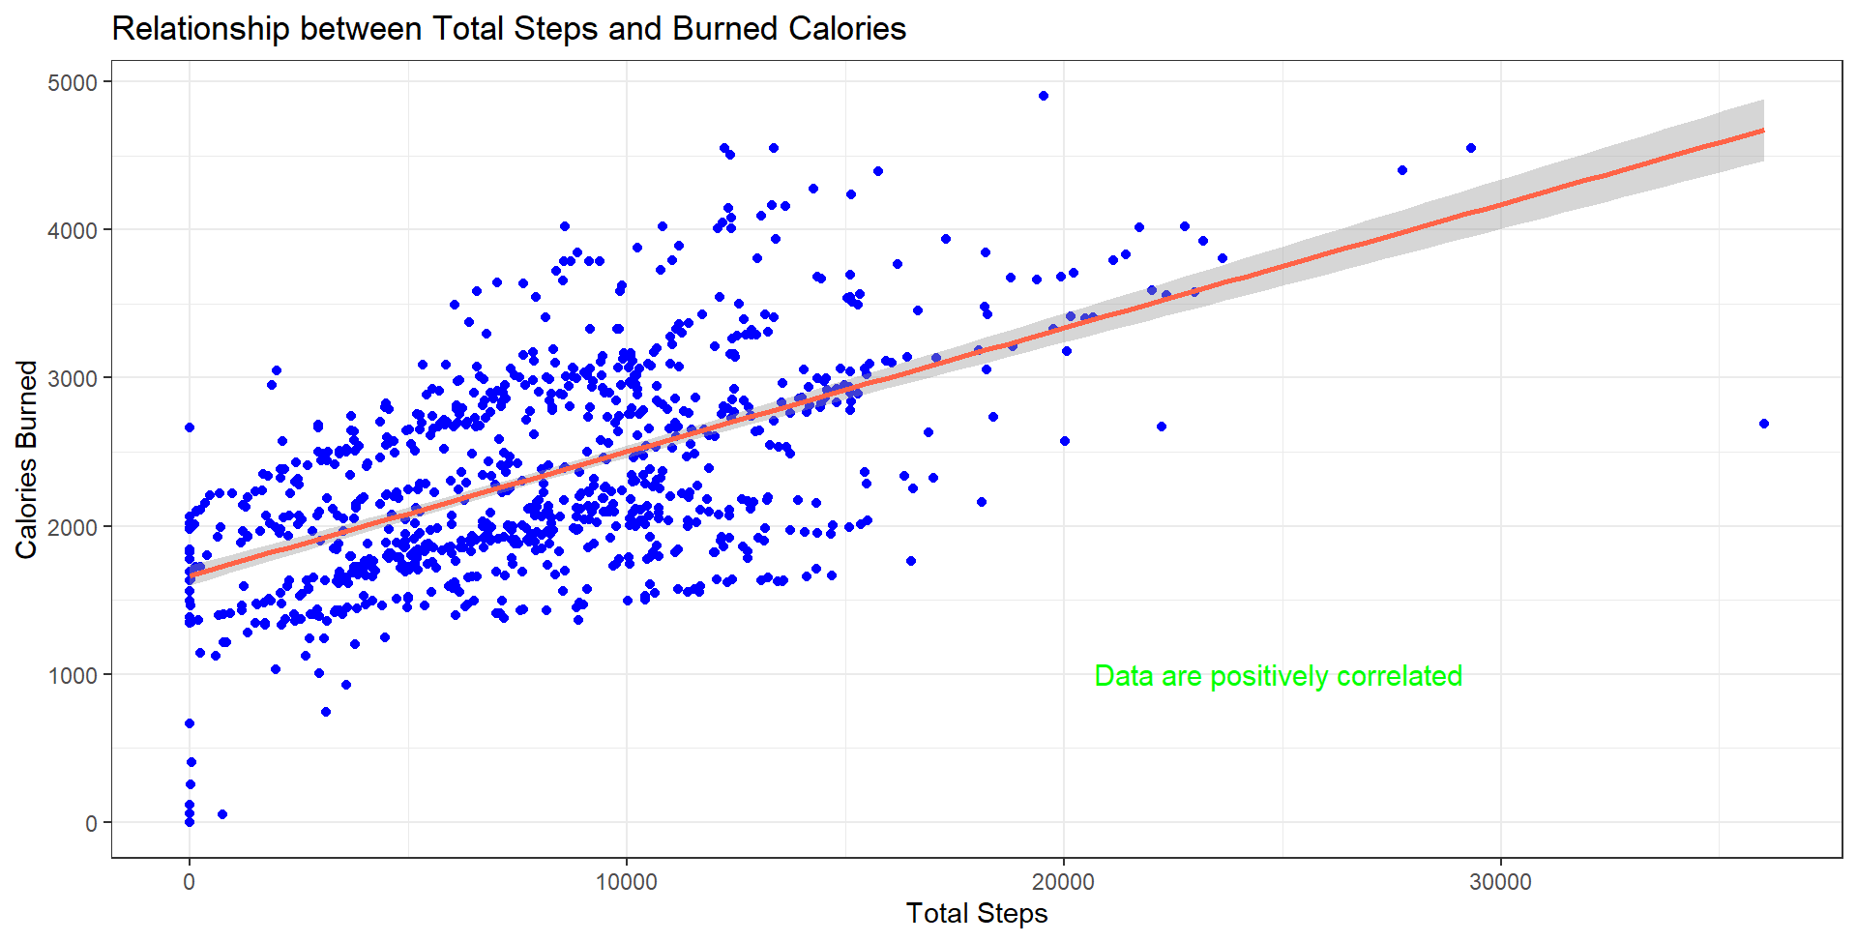
Daily Steps & Calories
Steps & Calories burned are positively correlated

Slide 21
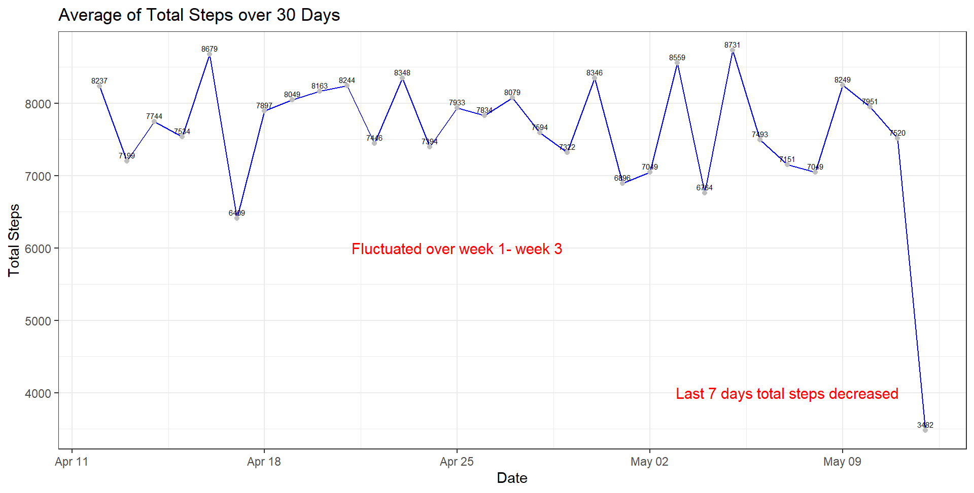
Daily Average of Total Steps
During weeks 1-3, there were fluctuations in participant activity (Steps).
Week 4 saw a drastic decrease in total steps

Slide 22
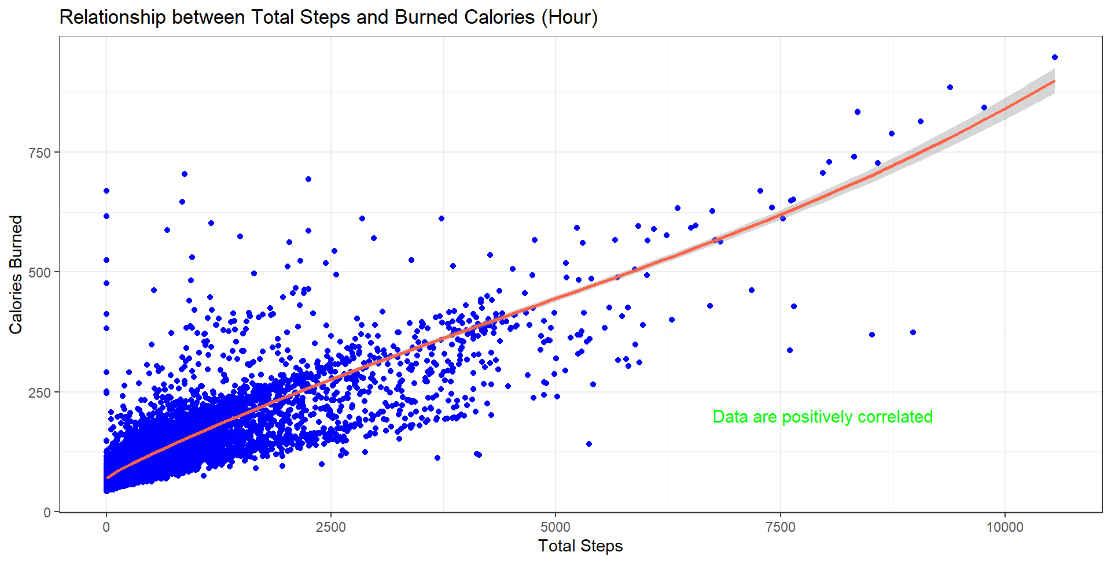
Hourly Steps & Calories
Steps & Calories burned are positively correlated

Slide 23
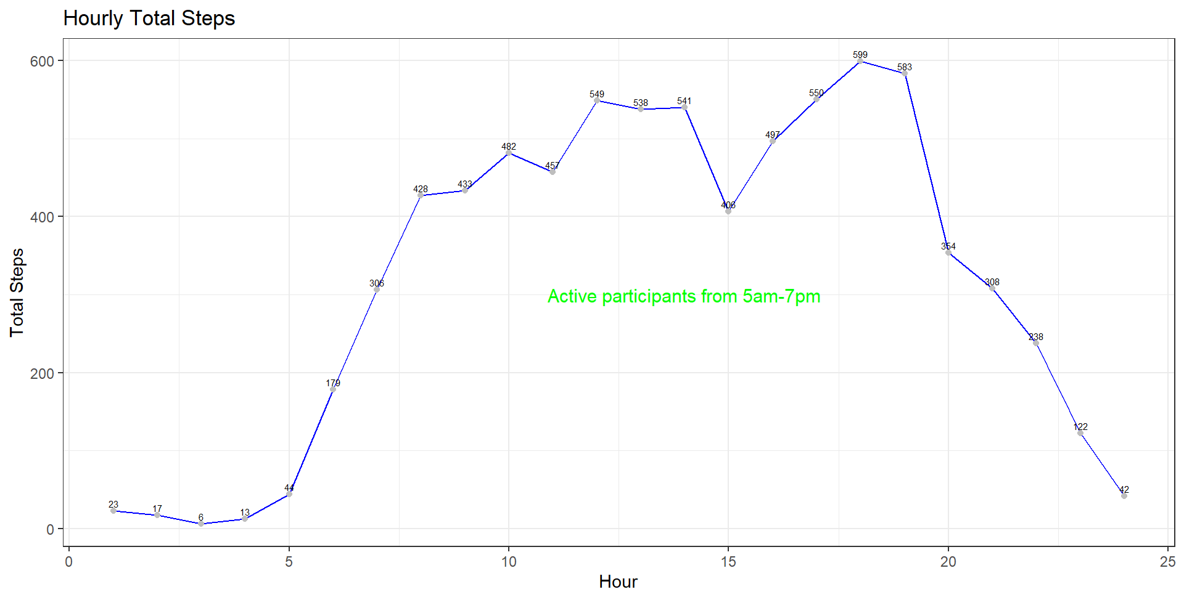
Hourly Average of Total Steps
Participants started to be active from 5 am - 7 pm.
Highest activity when returning home from work at 5-7 pm.

Slide 24
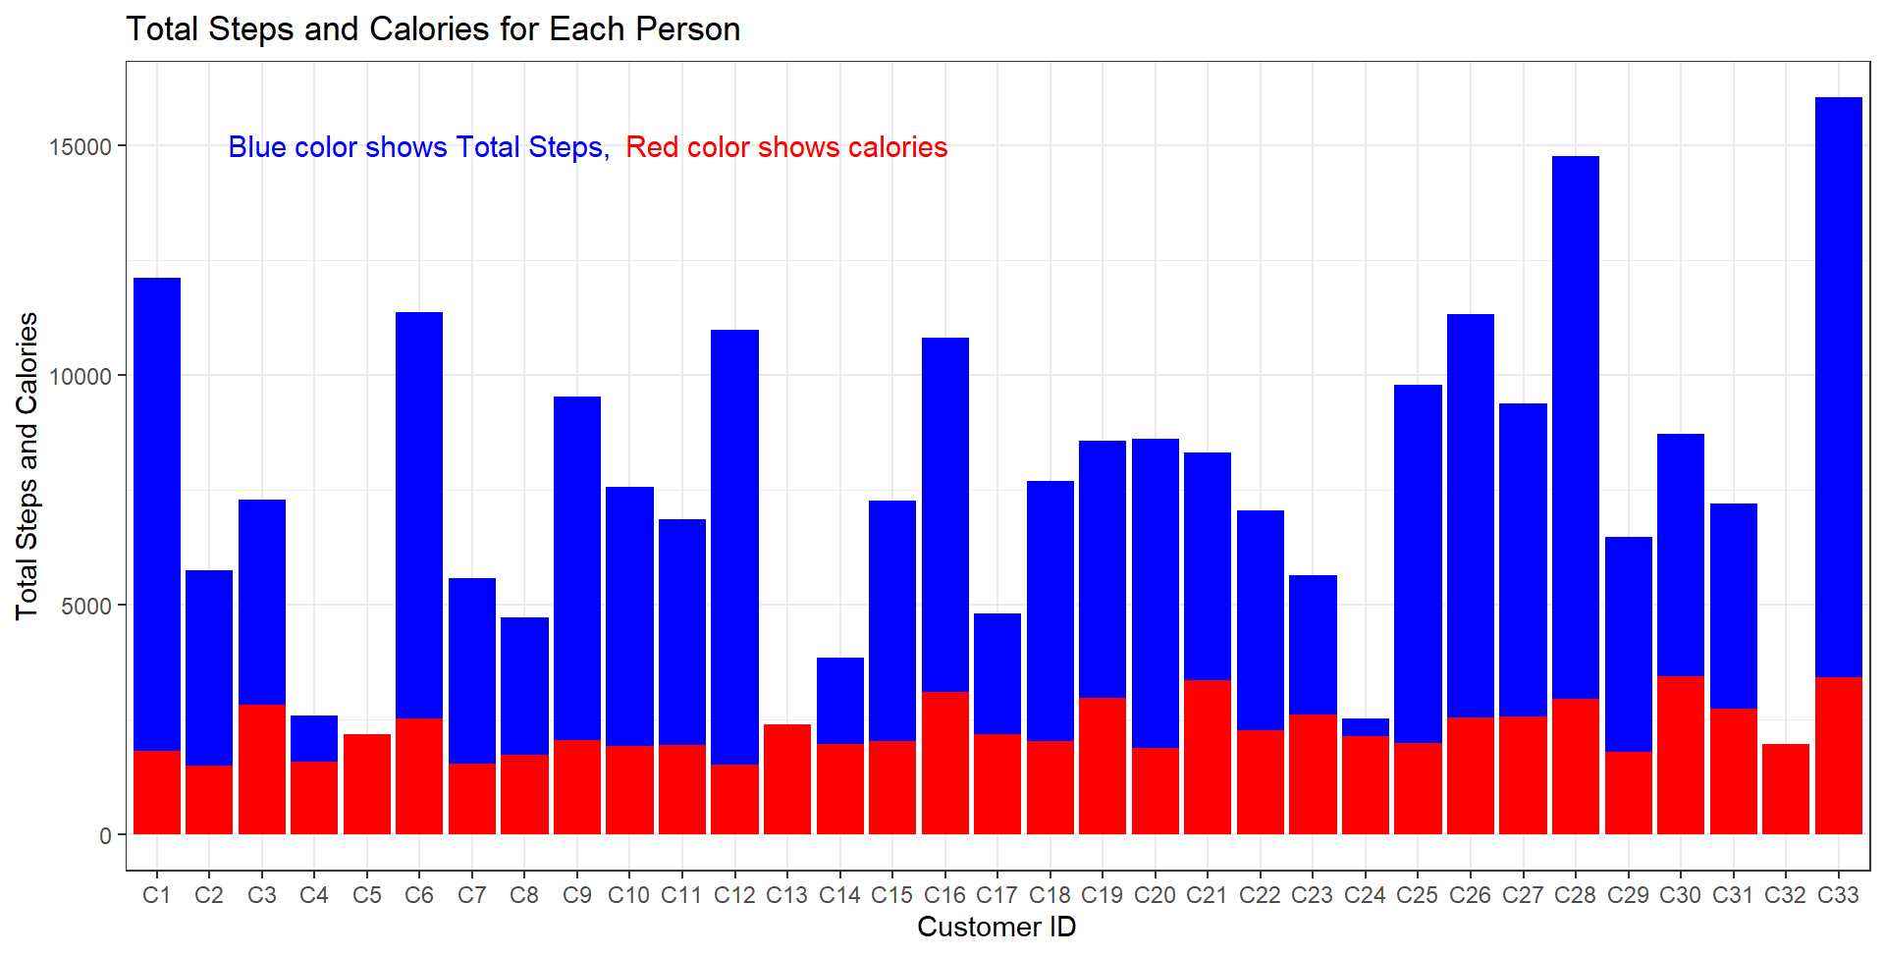
Steps & Calories (Each Steps)
The participant with the highest total steps was Participant 33 (8877689391) and the lowest was Participant 5 (1927972279).
The participant with the highest calories burned was Participant 30 (8378563200) and the lowest was Participant 2 (1624580081).

Slide 25
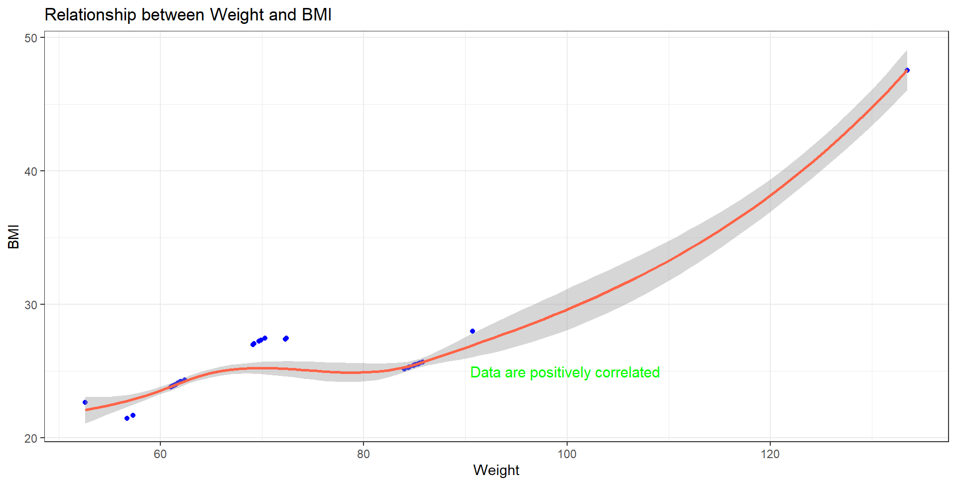
Weight & BMI
Weight & BMI are positively correlated

Slide 26
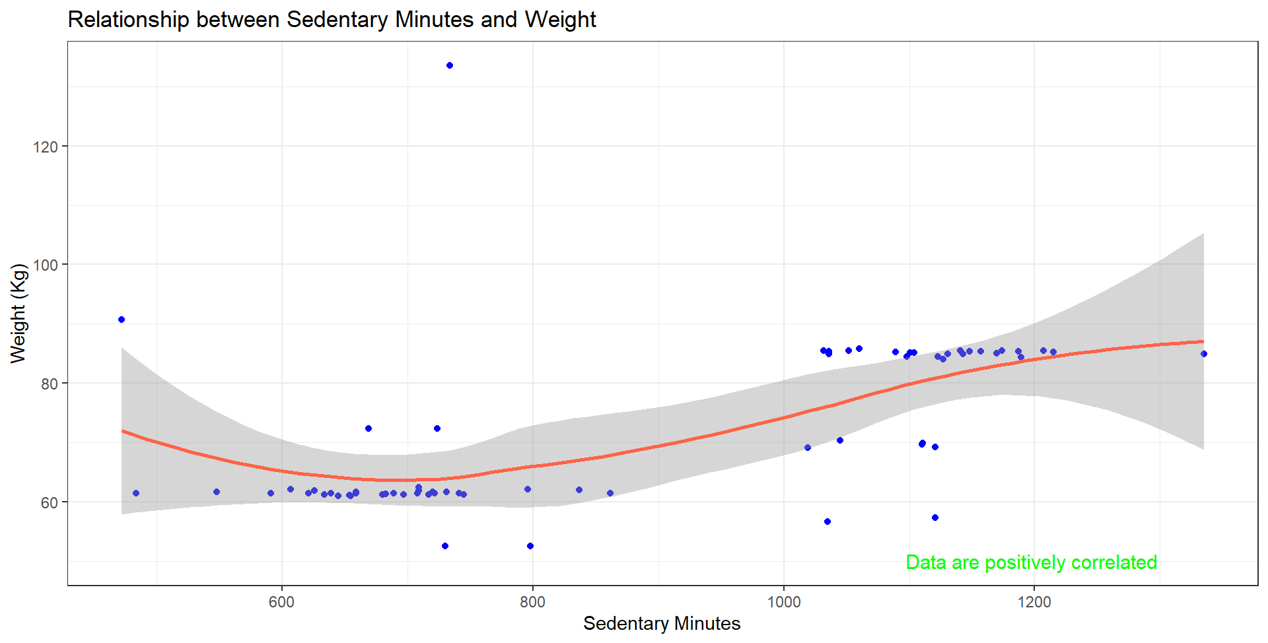
Sedentary Minutes & Weight
Sedentary Minutes & Weight are positively correlated

Slide 27
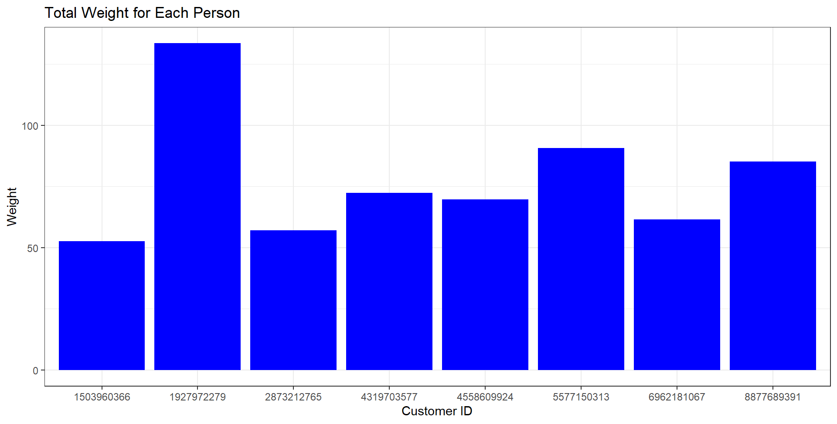
Total Weight (Each Steps)
The participant with the largest weight is the participant with Id 8877689391 and the lowest is participant 1 (1503960366).

Slide 28
Insight & Recommendation
The average total steps of all participants was 7638 steps, which is still less than what is recommended by The George Institute for Global Health. The Bellabeat app could develop features that encourage users to be more active. This could include notifications to get moving regularly, suggested exercise routines, or competitions with friends to boost motivation.
Given the correlation between weight, BMI, and physical activity, the company could provide more personalized advice to users based on their profiles. This feature can provide physical activity and nutrition recommendations that match individual health goals.January and February are the lowest months of Cyclistic bike usage. Use marketing strategies such as National Holiday Discounts to get customers back.
By monitoring sedentary and weight data, companies can develop analytics tools that help users understand the impact of sitting habits on long-term health. This could include suggestions for breaks or movement during long periods of sitting.

Slide 29
Thanks!
Do you have any questions?

Slide 30


